Slide 1
Disparity in Wages
Haleigh Borich

Slide 2
Questions
Is there a disparity within wages for…
Age
Race
Education
Marital Status
How has pay fluctuated throughout time for Men and Women?
Notes:
One of the most important things I highly value is the fight for equality.
In the more recent years the fight for equal pay in all aspects has increased and it has become a vocal point for many groupings of people.
The purpose of this research project is to see how the discrepancy between wages in all different kinds of backgrounds. I formulated this questions in order to detect if there is still a disparity within wages.

Slide 3
Disparities within Gender
Notes:
In the more recent years, the fight for equal pay for Women has become a more popular topic. To this day, women, who work the same jobs as men, receive a lower pay than men. Many people try to dismiss this argument but I am here to prove that it is still an issue to this day.

Slide 4
Is there a disparity within wages for age groups?
Notes:
The first way we can detect any disparities is to look how men and women are getting paid regardless of identifying factors like race, and education

Slide 5
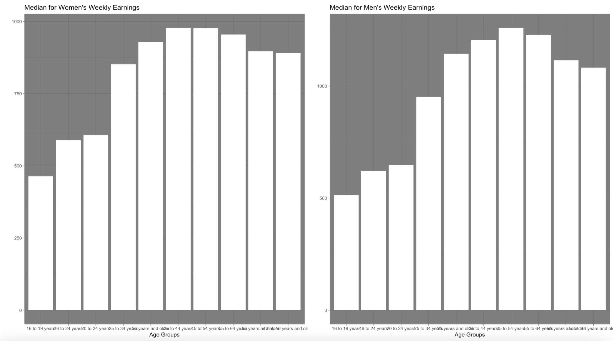
Notes:
With this data set, I was able to make age groups which span from 16 (legal working age) to 65 and older.
The age groups go as follows
16 - 19
20 - 24
25 - 34
35 - 44
45 - 54
55 - 64
65 +
While it may be hard to see within the graph, we can see that the age groups that have the highest pay for both men and women are 45 - 55
We can also see that while the two graphs look fairly similar, if we look close enough at the y - axis we can see that they are different. Women’s median cap for weekly pay stop a little short of 1,000$ however, men’s median cap for weekly pay is closer to 1,250$

Slide 6
Is there a disparity within wages for race?

Slide 7
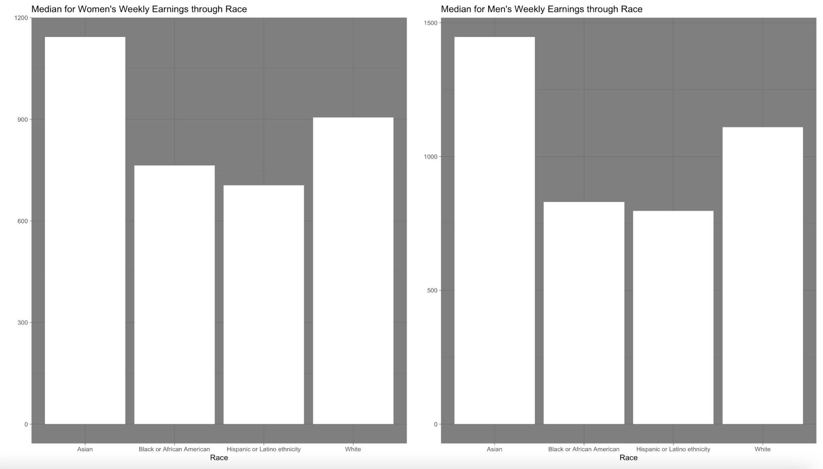
Notes:
Again we can see that the two graphs look fairly similar however, women's cap is lower than mens are.

Slide 8
Is there a disparity within wages for education?

Slide 9
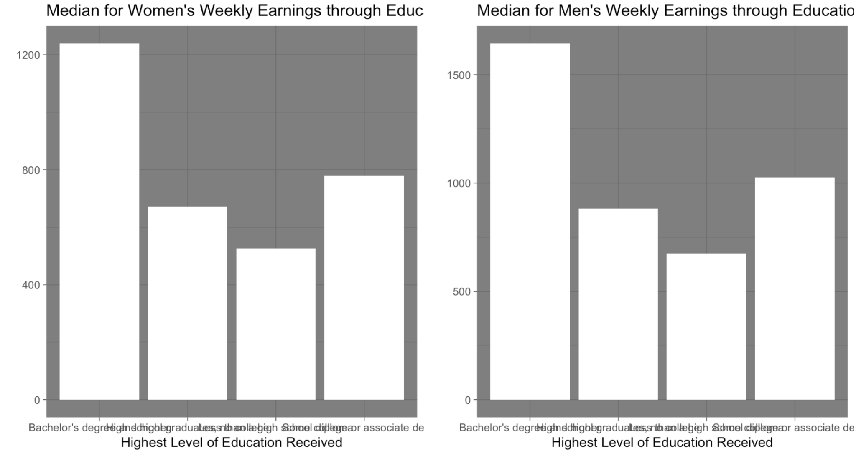

Slide 10
Is there a disparity within wages for marital status?

Slide 11
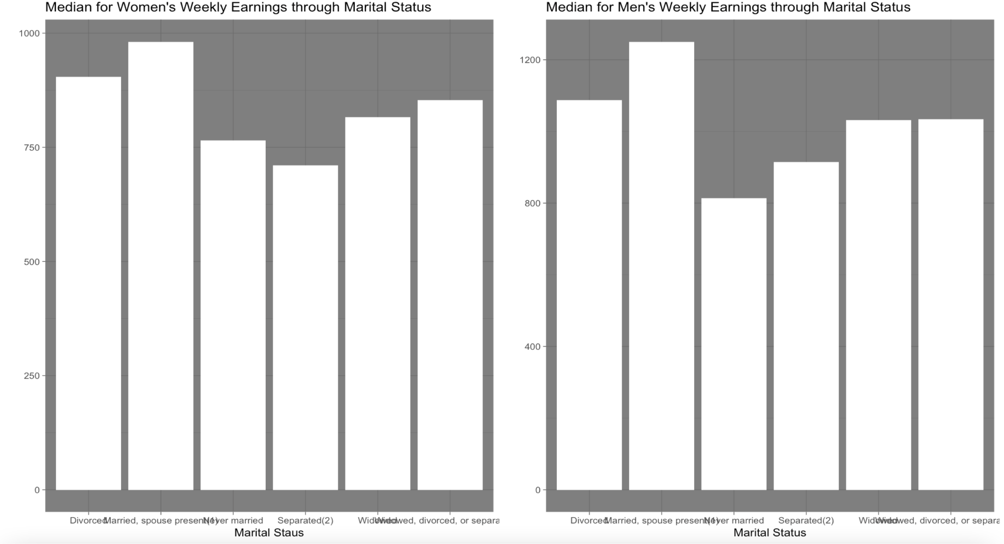

Slide 12
Disparities throughout the years

Slide 13
How has the average pay fluctuated throughout time for Women?

Slide 14
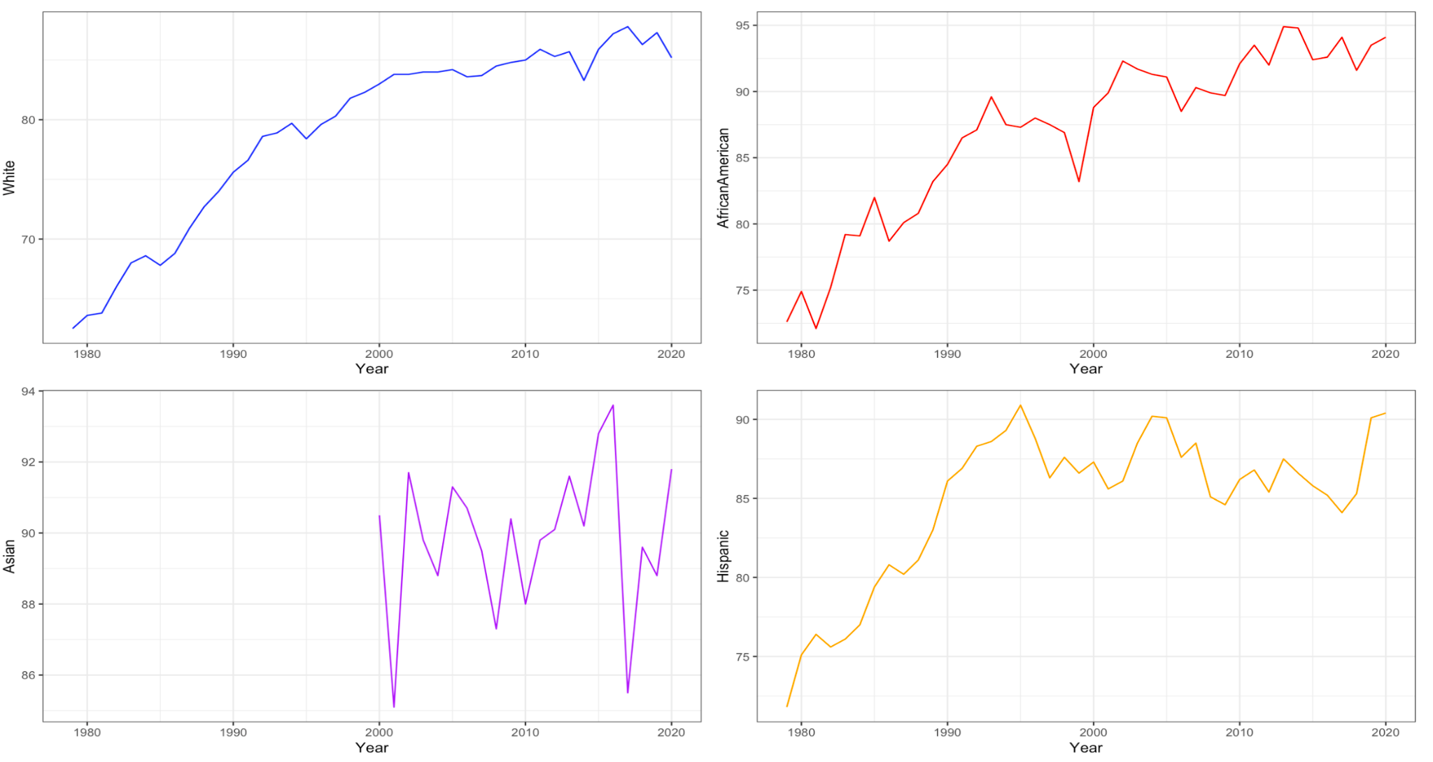
Notes:
While it seems as though women have been steadily getting paid more each year, we have to take inflation into consideration. As the inflation rates increase, as do pay for all. We cannot just attest this to women getting paid more or to the increased in minimum wage, it is simply because of inflation rates.

Slide 15
How has the weekly pay fluctuated throughout time for Women and Men?

Slide 16
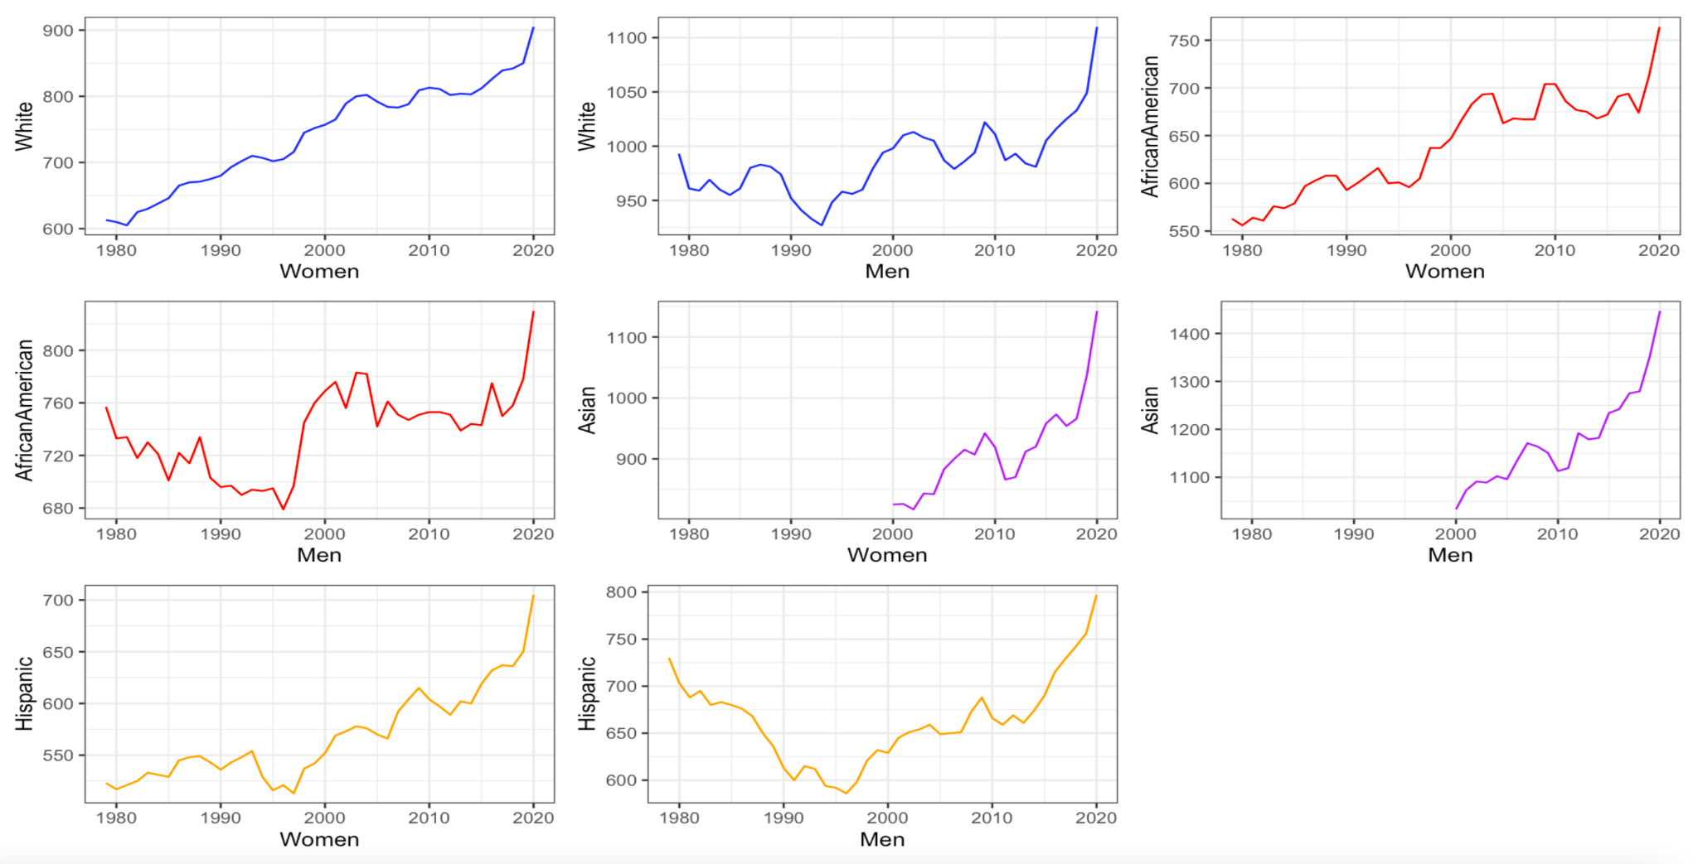
Notes:
Here we are looking at the weekly pay for men and women over time and as we can see women have had a steady increase in all aspects but when we look at the overview in the year 2020, we can see that women still, to this day, do not receive the same pay as men do.

Slide 17
Overview
Notes:
I do not believe this is something that can continue to be swept under the rug. We have to break away from the monotony of older generation norms and recognize women for the amazing attributes they can add into the workplace

